Slide 1
URBAN SOUND CLASSIFICATION USING DEEP LEARNING

Slide 2
By: epuru sai muralidhar revanth balineni Shashank reddy kapu

Slide 3
PROBLEM STATEMENT
Our project focuses on classifying urban sounds using deep learning, specifically Convolutional Neural Networks (CNNs). This is crucial for applications like public safety and urban planning, where accurate sound classification can enhance environmental monitoring and response systems, improving urban living conditions and operational efficiency.

Slide 4
Urban sound classification often employs deep learning for its pattern recognition strength, utilizing 'spectrograms for feature extraction'.
Previous studies, such as those using the UrbanSound8K dataset, typically involve CNNs that classify sounds like car horns and sirens based on these features

Slide 5
Approach
Our approach enhances these models by incorporating deeper convolutional layers and extensive normalization, coupled with dynamic parameter adjustments during training. This methodology aims to improve adaptability and reduce overfitting, setting our project apart from more static training models in earlier works

Slide 6
Dataset
Our project utilizes the Urban Sound Classification dataset, comprising urban audio files from folds 1 to 4, including gunshot sounds.
We preprocess the data by converting audio files into mel-spectrograms, normalizing amplitudes to decibels, and scaling pixel values. These steps ensure uniform data representation essential for accurate deep learning model training.

Slide 7
Methods
Model Overview
Hybrid Model Design – Transformer model (best model)
Hybrid Model combines CNNs for feature extraction and Transformers for sequence analysis.
Three CNN layers (128, 256, 128 filters), each followed by max pooling.
Positional Encoding added post-CNN for temporal context.
Transformer uses multi-head attention to enhance dependency capture.

Slide 8
Comparisions
Tested Basic CNN Model for straightforward spatial feature extraction.
Explored CNN-LSTM Hybrid for temporal dependencies, less effective for urban sounds.
Evaluated Enhanced CNN Model, improved but lacked temporal depth.
Best performance achieved with CNN-Transformer Hybrid.

Slide 9
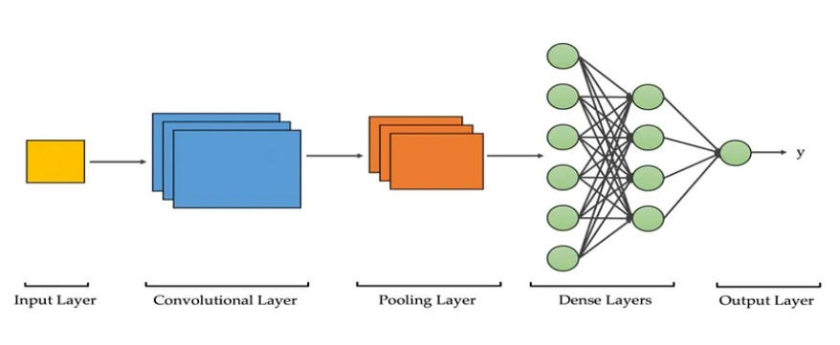
Model Architecture:

Slide 10
The Convolutional Neural Network (CNN) architecture was structured as follows:
Input Layer: Accepts the preprocessed spectrogram data.
Convolutional Layers: Three layers with ReLU activation to extract features.
Max Pooling Layers: Positioned after the first and second convolutional layers to reduce dimensionality.
Flattening Layer: Converts 2D feature maps into a 1D vector.
Dense Layers with Dropout: Two layers with dropout in between to prevent overfitting.
Output Layer: A dense layer with SoftMax activation that outputs a probability distribution over 10 classes.

Slide 11
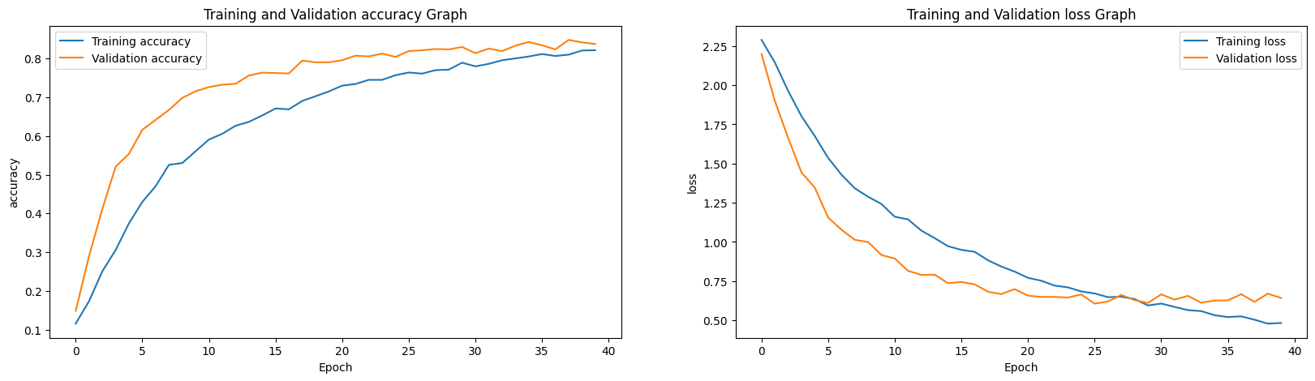
Result Evaluation

Slide 12
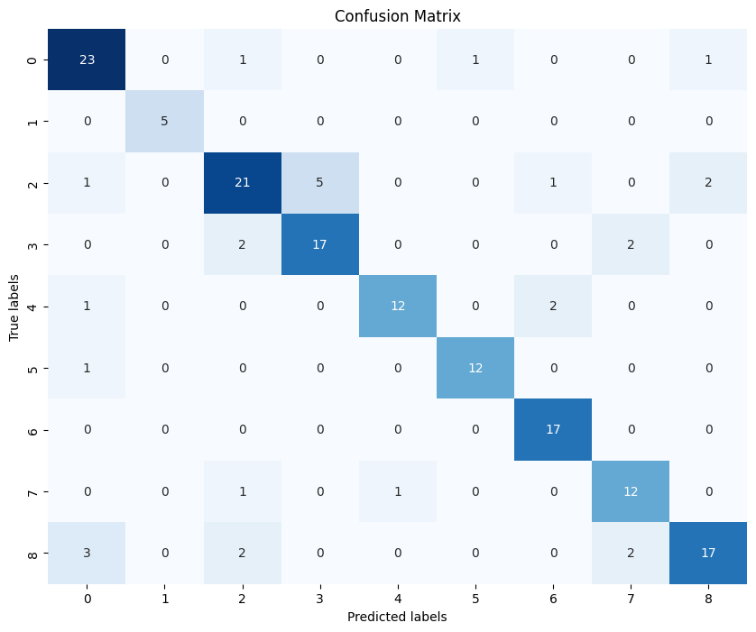
Confusion Matrix

Slide 13
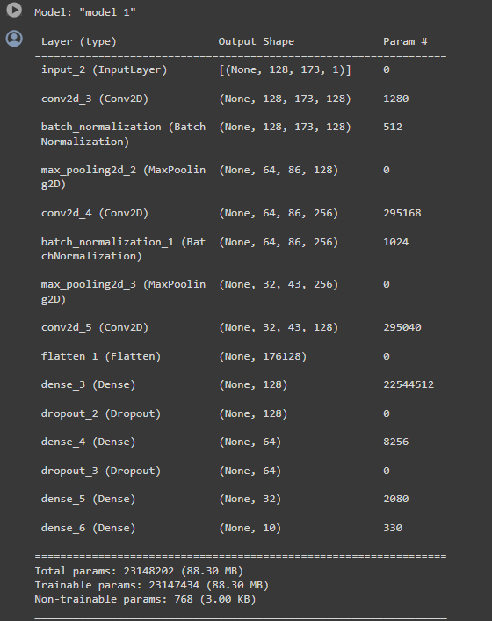
Hyperparameter optimized model:
Input Specification: Accepts grayscale images of 128x173 pixels.
Convolutional Layers:
Layer 1: 128 filters, batch normalization.
Layer 2: 256 filters, batch normalization.
Layer 3: 128 filters, batch normalization.
Pooling Layers: Two max pooling layers reducing dimensions by half.
Flattening and Dense Layers:
Flattening layer transforms 3D feature maps to 1D vectors.
Dense layers: 128, 64, 32 units with dropout (0.3) after the first two.
Output Layer: 10 units with SoftMax activation for multi-class classification.
Optimization and Loss: Adam optimizer and categorical cross-entropy loss.

Slide 14
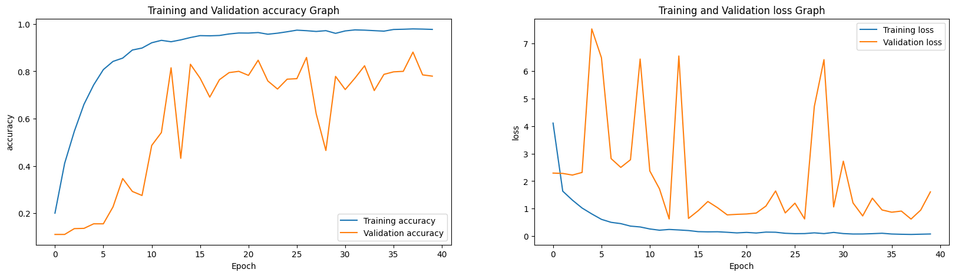
Result Evaluation

Slide 15
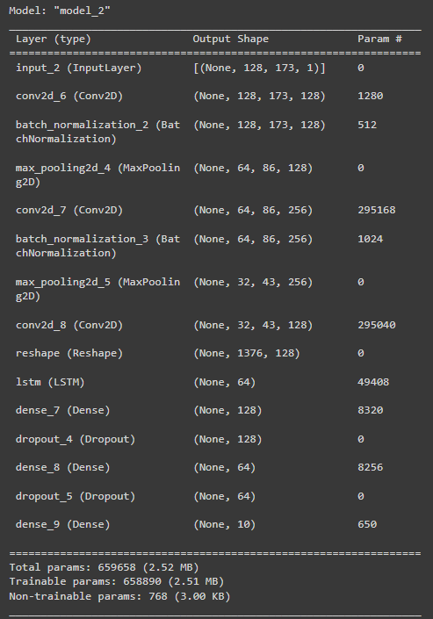
Enhanced CNN-LSTM Model Architecture
Input Layer: Processes single-channel grayscale images (128x173 pixels), suitable for capturing temporal dynamics.
Convolutional Layers:
1st Layer: 128 filters, batch normalization.
2nd Layer: 256 filters, batch normalization.
3rd Layer: Returns to 128 filters, batch normalization.
Pooling Layers: Two max pooling layers reduce dimensionality, decreasing complexity and aiding in overfitting prevention.
Reshape Layer: Adapts convolutional output for LSTM layer, transitioning from spatial to temporal processing.
LSTM Layer: A single LSTM with 64 units captures temporal dynamics essential for sequence data.
Dense and Dropout Layers:
1st Dense Layer: 128 units.
2nd Dense Layer: 64 units.
Dropout: Applied after each dense layer to mitigate overfitting, dropout rate of 0.3.
Output Layer: 10 units with SoftMax activation for multi-class classification.

Slide 16
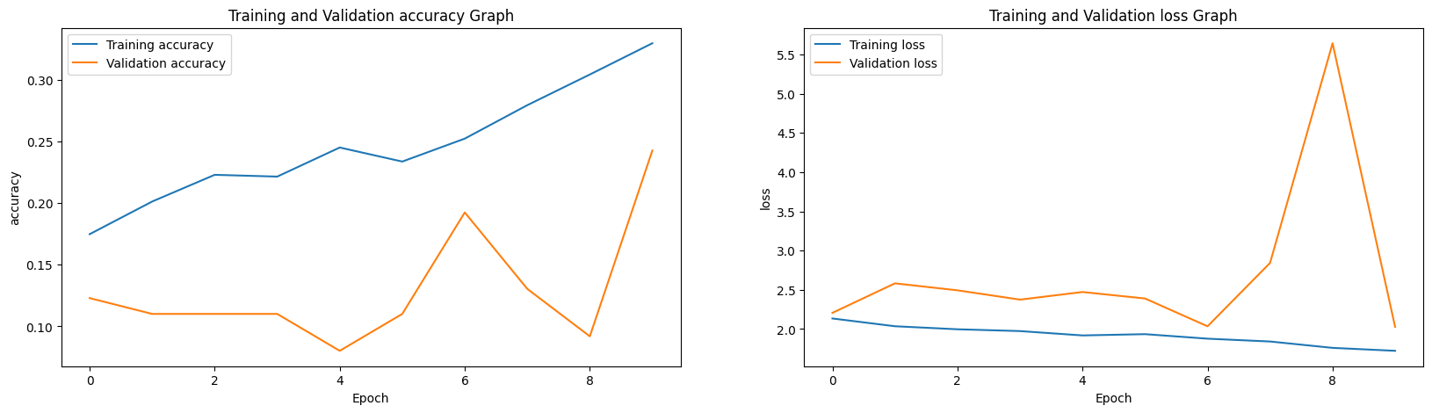
Result Evaluation

Slide 17

Model Architecture:

Slide 18
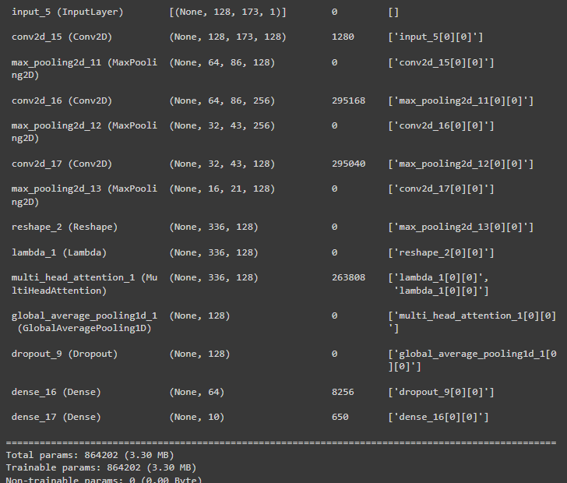
Transformer Model Architecture
Input Layer: Handles 128x173 pixel grayscale images.
CNN Layers:
Conv Layers: Three layers with 128, 256, 256 filters using 3x3 kernels and ReLU.
Pooling: Three max pooling layers reduce feature dimensions.
Output Processing:
Pooling: Global average pooling condenses features.
Dropout: Mitigates overfitting.
Dense Layers: 64 units then 10 units for classification.
Output Layer: SoftMax for 10-class distribution.
Optimization: Adam optimizer with categorical cross-entropy loss.

Slide 19
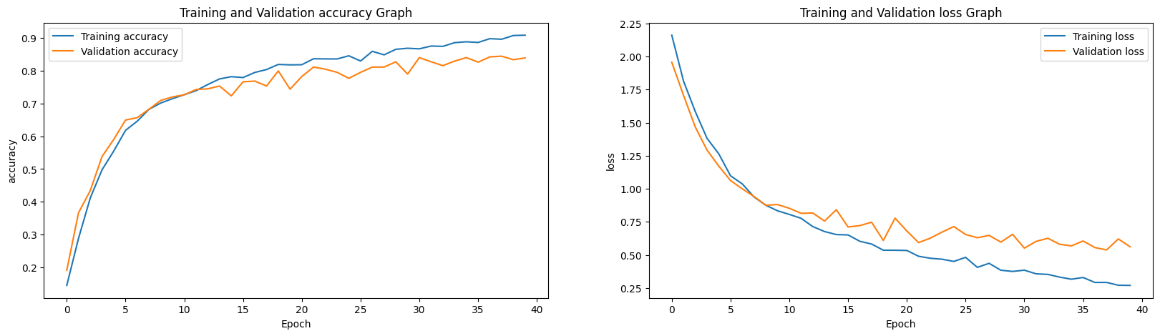
Result Evaluation

Slide 20
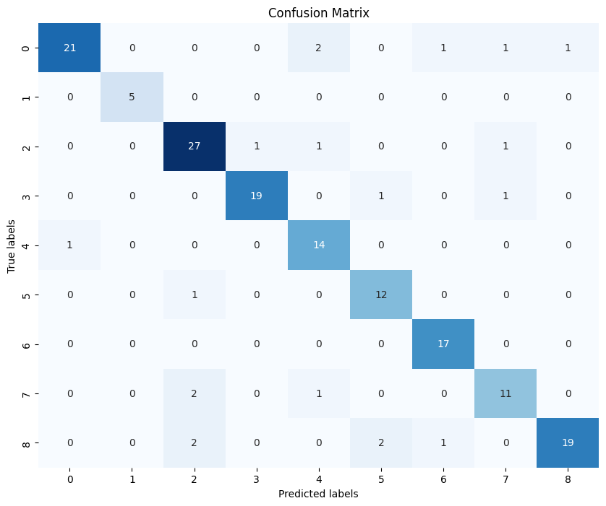
Confusion Matrix

Slide 21
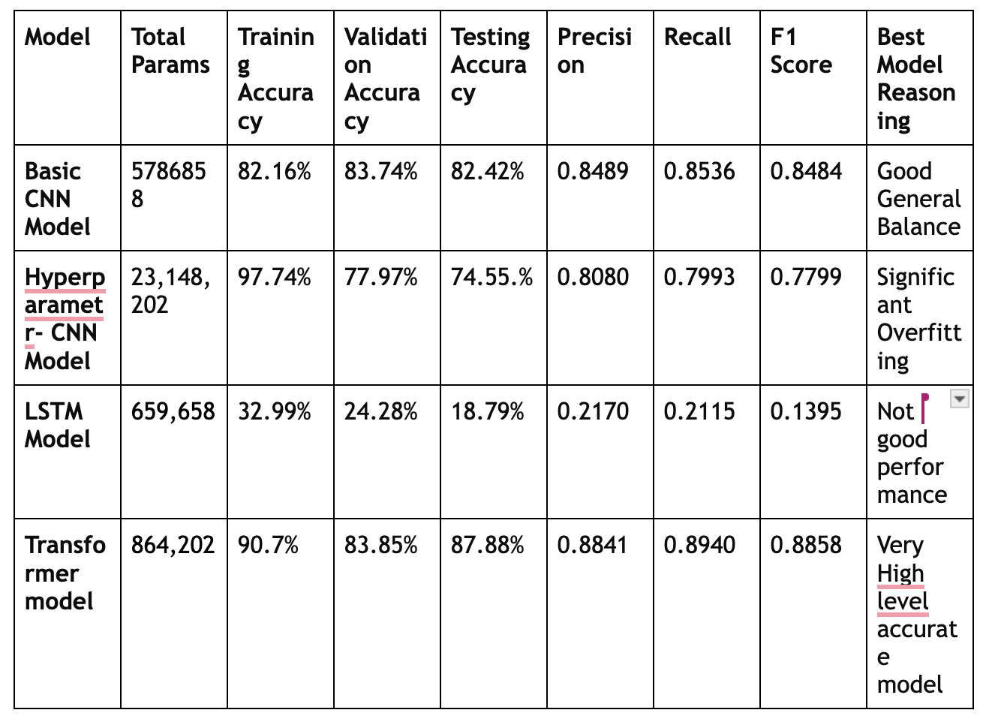
Analysis Table
Model accuracies and metrics

Slide 22
Key Observations
Feature Extraction: Convolutional layers with increasing filters enhance spatial feature detection.
Efficiency: Max pooling reduces dimensions, optimizing computational speed.
Dependency Mapping: Multi-head attention in Transformers captures complex data relationships.
Precision & Robustness: Global pooling and dropout layers ensure accurate predictions and prevent overfitting.

Slide 23
Contributions:
Epuru Sai Muralidhar | 50537867 | 33.33%
Revanth Balineni | 50540873 | 33.33%
Shashank Reddy Kapu | 50533630 | 33.33%

Slide 24
THANK YOU

